Slide 1
COM-I ( Introduction to Business)
Dr. Sumita Shankar

Slide 2
FUNCTIONS OF BUSINESS

Slide 3
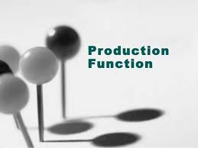
Production function

Slide 4

2. Purchase and store keeping

Slide 5

3. Marketing function

Slide 6

4. SALES FUNCTION

Slide 7

5. FINANCE FUNCTION

Slide 8

                6. HRM OR PERSONNEL MANAGEMENT

Slide 9

7. RESEARCH AND DEVELOPMENT

Slide 10

8 . PUBLIC RELATIONS

Slide 11


